Slide 1
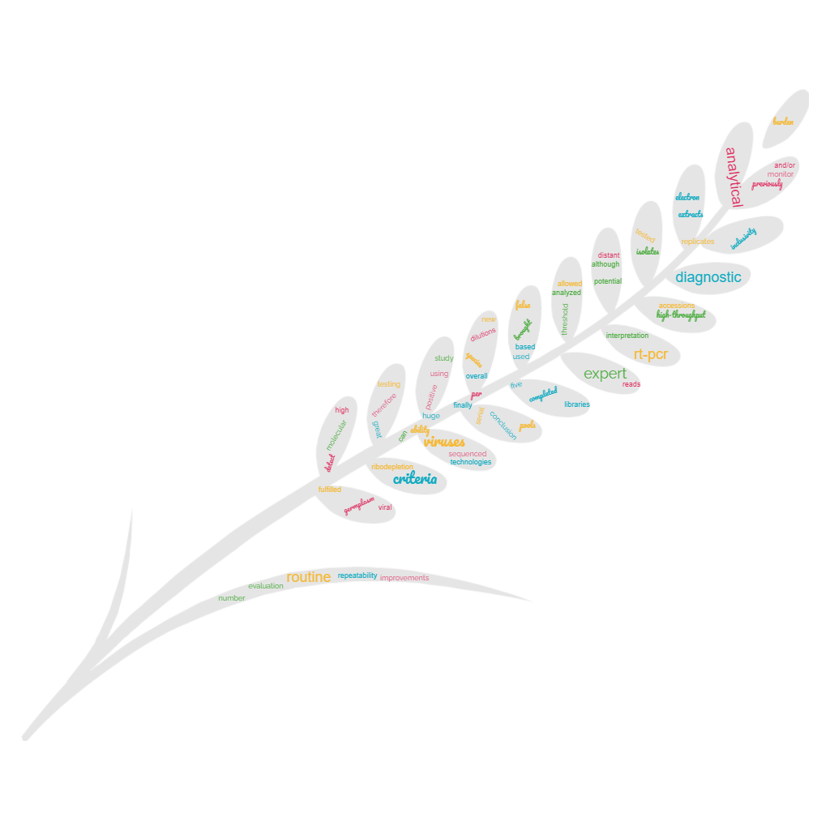

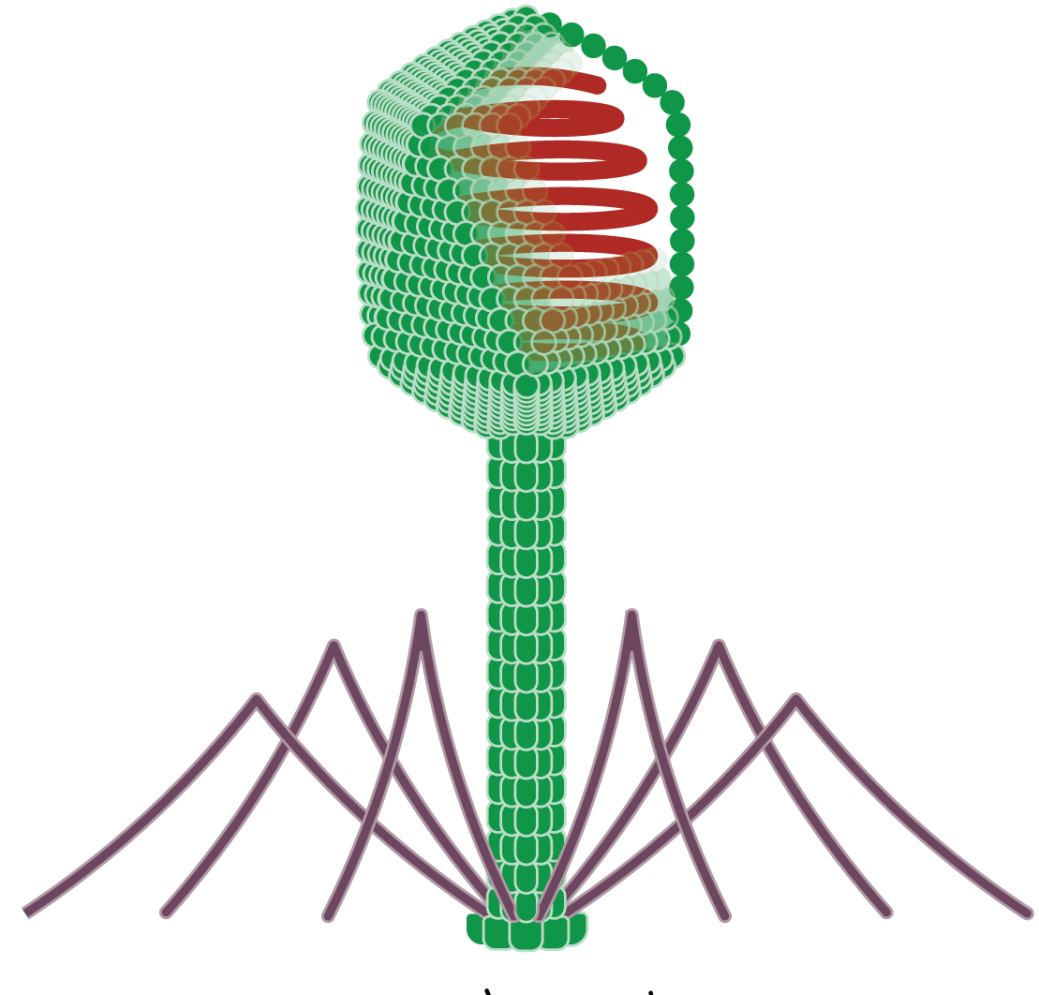




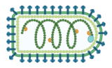


HTS analysis to improving viral detection in plant
Supervisor:
Maxime Devos (DNAV)
Sebastien Massart (ULIEGE)
Yves Brostaux (ULIEGE)
ESR 11: Johan Rollin
DNAVision, 6041, Gosselies, Belgium
University of Liège, Gembloux Agro-Bio Tech, Plant Pathology Laboratory, 5030, Gembloux, Belgium
May 2022

Slide 2
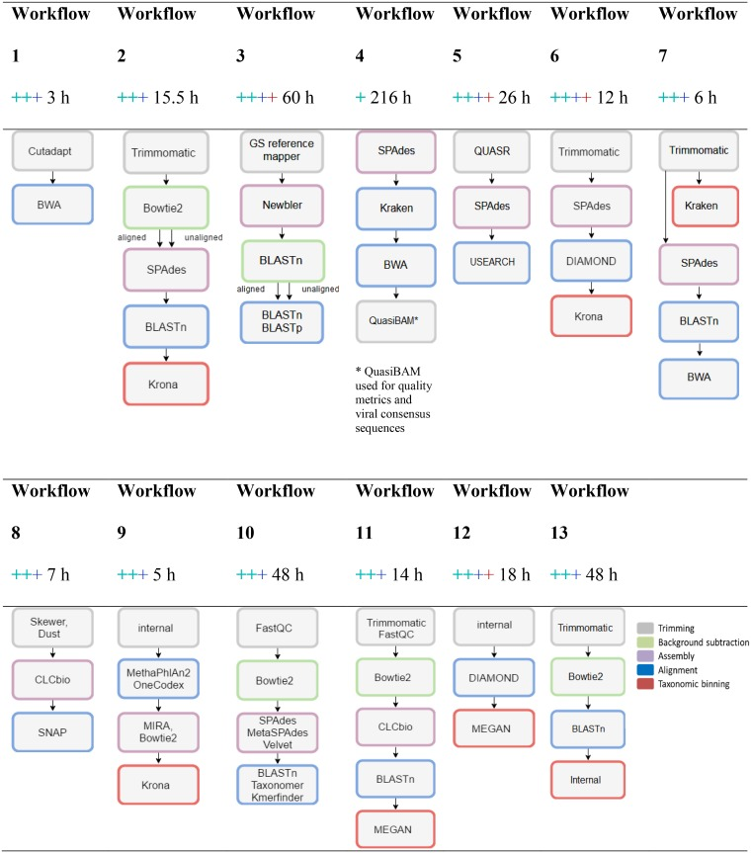
Introduction
Brinkmann.A et al. “Proficiency Testing of Virus Diagnostics Based on Bioinformatics Analysis of Simulated In Silico High-Throughput Sequencing Data Sets.” Journal of Clinical Microbiology 57, no. 8 (July 26, 2019). https://doi.org/10.1128/JCM.00466-19.

Slide 3

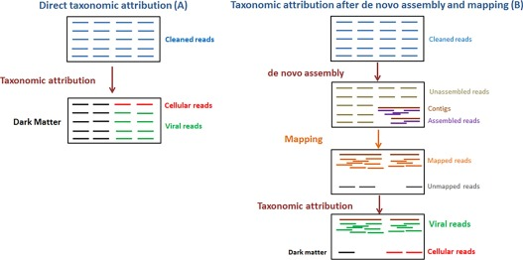
Virus detection
Direct taxonomic assignation IS NOT
An abundance estimation
François, S., et al. “Increase in Taxonomic Assignment Efficiency of Viral Reads in Metagenomic Studies.” Virus Research 244 (January 15, 2018): 230–34. https://doi.org/10.1016/j.virusres.2017.11.011.

Slide 4
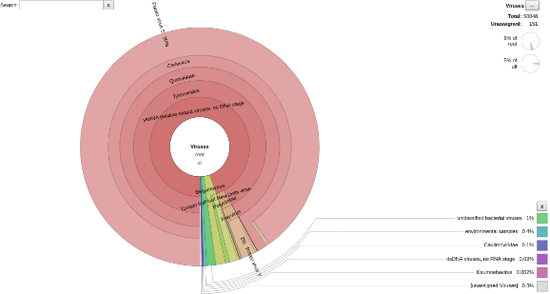
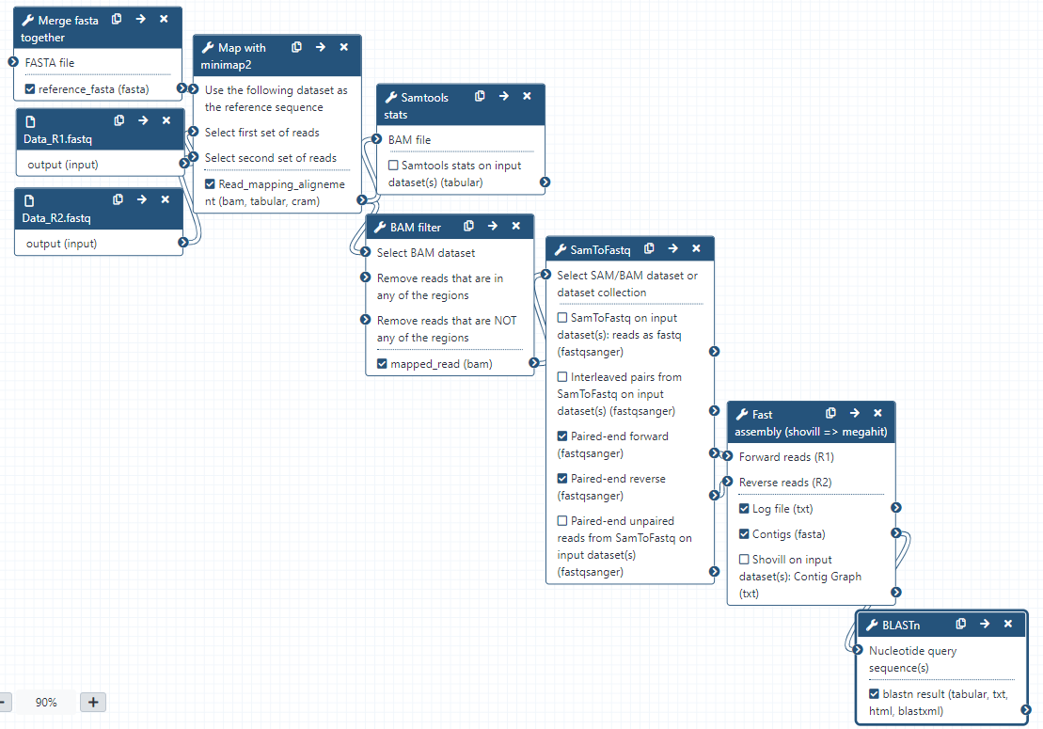
Virus detection
Workflow 1
Workflow 2
⇒ Fast
⇒ Result easy to reads
⇒ Don’t miss any present known virus (so far)
⇒ A lot of false hits
⇒ Confirm presence of virus
⇒ Find the closest reference
⇒ Hard to read the result
+ BLAST
Already available !
François, S., et al. “Increase in Taxonomic Assignment Efficiency of Viral Reads in Metagenomic Studies.” Virus Research 244 (January 15, 2018): 230–34. https://doi.org/10.1016/j.virusres.2017.11.011.

Slide 5
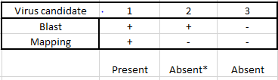
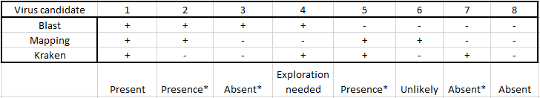
Virus detection: interpretation
Workflow 1
Workflow 2
Kraken
Blast
Make plant virus analysis:
Easier
Faster
Reliable
Mapping
The precision can be very high (up to ~20 reads)

Slide 6
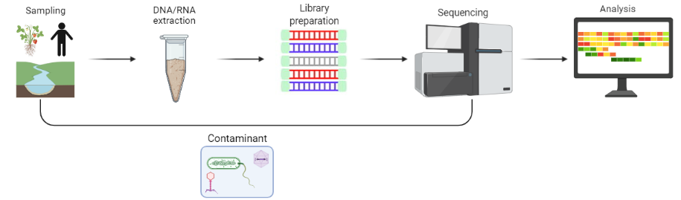
Introduction: Cross-contamination
Cross-sample contamination
2

Slide 7


Introduction: Monitoring contamination
Cross-sample contamination
Alien control
Monitor transfer of DNA/RNA between sample
2

Slide 8

Introduction: Monitoring contamination
Alien control
For plant virus diagnostics, an alien control corresponds to a plant sample containing one or several plant viruses (called alien viruses) that cannot be present in the tested samples Reads from an alien virus in a tested sample can be unequivocally considered as a contamination from the alien control (Massart et al., in preparation).
2

Slide 9
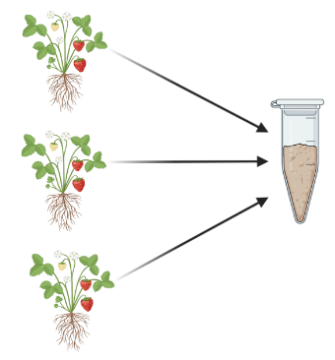
Standard Pooling overview
Sample 1

Slide 10
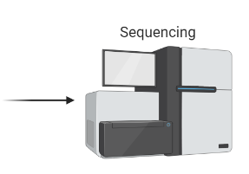
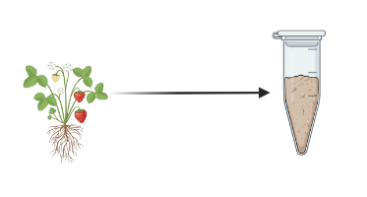
Standard Pooling overview
Sample 1
Coline survey ➔ ~2000plants
Sequencing price estimation
(NEBNext Ultra II + NovaSeq S4 ➔ ~100€ / sample)
100 plants
➔ 2 000€
➔ 200 000€
Strategy I
Strategy II
Sample 2
Sample 3

Slide 11
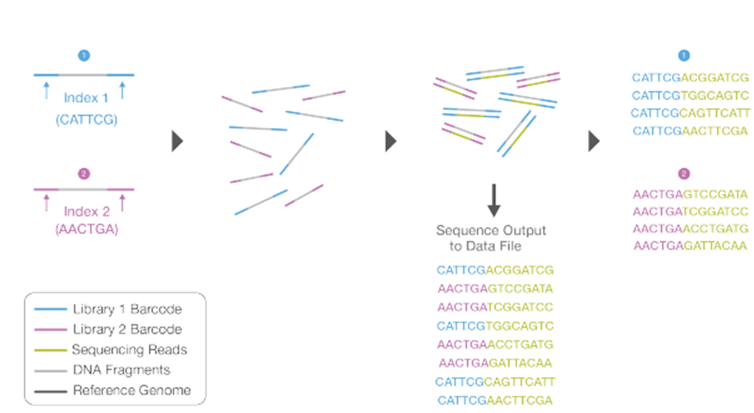
Multiplexing overview
Sample

Slide 12

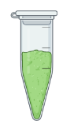
Multiplexing overview
10X
Sample pool ➔ library
Strategy I
Strategy II
➔ 200€
➔ 20 000€
Sample 2
Sample X
10X
Sample pool ➔ library
Sample 3
Sample X
Pooling + Multiplexing allow to analyze at low cost

Slide 13
Multiplexing overview
Sample

Slide 14
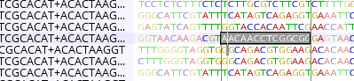
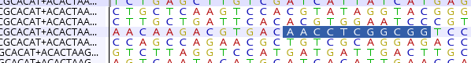
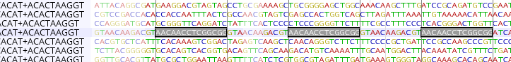
Demultiplexing problems:
Primers are not found at reads extremity
mutation/sequencing error on primer
Multiple primer
Cropped reads (14-mers missing)
Primer from different mid on same reads pair (hybrid reads pair)

Slide 15
One
Demultiplexing method:
Sample 1
Same
Library x:
Mid 1
Mid 2
Mid 3
One
Sample 2
Same
one tag found on the two paired reads
No tag
One
Sample 3
low confidence
Both different tag
Library x Unknown
reads with no tag in the pair
Library x Hybrid
reads with different tag for each read of the pair
Same
medium confidence
same tag for both read of the pair
High confidence

Slide 16
Detection path:
10-30% reads
30-80% reads
50-95% reads
Same
One
One /+ Same
ViralRNASPAdes
Kraken
Mapping
A lot of FP
No (so far) FN
Contig
Confirmation
Tblastx on viral RefSeq
Detection
check conta with
Exploration
High TP confidence
Not a lot of FP

Slide 17
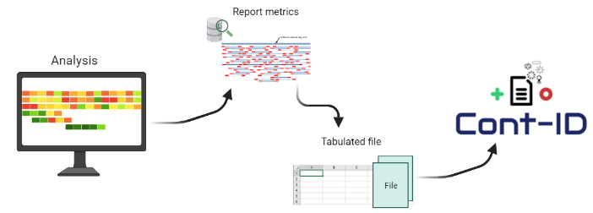

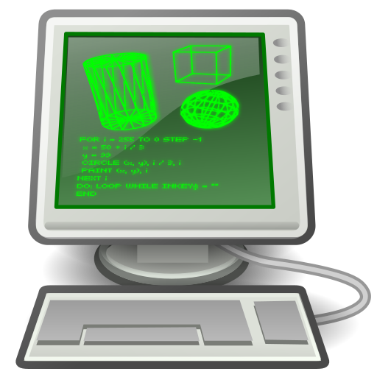


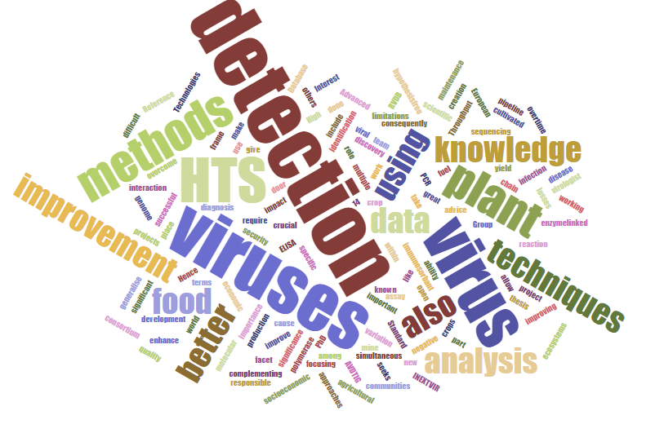
Conclusion
Demultiplexing improvement
Better contig reconstruction
Cross-sample contamination
Prediction
Better detection
12

Slide 18






Acknowledgement
Partner organizations
INEXTVIR is implemented by a European Consortium of universities, research institutions and companies in Belgium, France, Spain, Slovenia and the UK.
This project has received funding from the European Union’s Horizon2020 research and innovation programme under the Marie Sklodowska-Curie grant agreement n° 813542

